Slide 1
Introduction to Data Science Data Mining for Business Analytics
Brian d’Alessandro
VP – Data Science, Dstillery
Adjunct Professor, NYU
Fall 2014
Fine Print: these slides are, and always will be a work in progress. The material presented herein is original, inspired, or borrowed from others’ work. Where possible, attribution and acknowledgement will be made to content’s original source. Do not distribute, except for as needed as a pedagogical tool in the subject of Data Science.
Notes:
https://www.youtube.com/watch?v=aMDe5pODkB0 (harlan harris)

Slide 2
Exploratory analysis : Finding structure

Slide 3
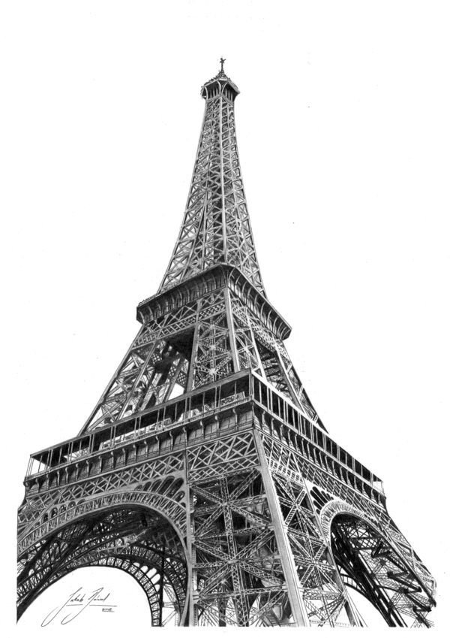
discussion
What do we mean by data having structure?
Why do we want to understand it?
What do we do with it?
Notes:
The goal of finding structure is to information from one source to reduce uncertainty about another source.
What does this mean? Conditional distribution example. I.e., carnival guy who guesses your weight. If I can see your height I can reduce uncertainty about weight.
Find some height/weight data.
Under supervised exploration:
How can we (automatically) obtain a selection of the more informative variables with respect to predicting the value of the target variable?
Even better, can we obtain the ranking of the variables?
Can think of importance as one that makes the target variable more pure. This leads to the notion of entropy.

Slide 4
information
any quantity that can reduce uncertainty about another quantity
Notes:
The goal of finding structure is to information from one source to reduce uncertainty about another source.
What does this mean? Conditional distribution example. I.e., carnival guy who guesses your weight. If I can see your height I can reduce uncertainty about weight.
Find some height/weight data.
Under supervised exploration:
How can we (automatically) obtain a selection of the more informative variables with respect to predicting the value of the target variable?
Even better, can we obtain the ranking of the variables?
Can think of importance as one that makes the target variable more pure. This leads to the notion of entropy.

Slide 5
(aside) Conditional thinking
So much of what we do in data science involves thinking in terms of…
E[Y|X]
And deciding whether or not E[Y|X] ≠ E[Y]
From a decision making standpoint, conditional thinking is being able to make a better judgment about a potential outcome Y if we were to know the value of X.
Notes:
Do the demo as well

Slide 6
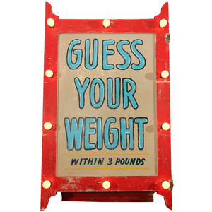
Information example
If a carnival operator wanted to reduce the uncertainty about your weight, what information might he use?
Notes:
The goal of finding structure is to information from one source to reduce uncertainty about another source.
What does this mean? Conditional distribution example. I.e., carnival guy who guesses your weight. If I can see your height I can reduce uncertainty about weight.
Find some height/weight data.
Under supervised exploration:
How can we (automatically) obtain a selection of the more informative variables with respect to predicting the value of the target variable?
Even better, can we obtain the ranking of the variables?
Can think of importance as one that makes the target variable more pure. This leads to the notion of entropy.

Slide 7
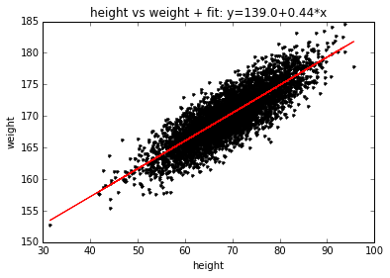
Reducing uncertainty
Let’s assume our carnival friend is also a data scientist
Step 1 – Collect data, height vs. weight, regress
By regressing we can learn:
E[Weight|Height]
as opposed to
E[Weight].
Notes:
The goal of finding structure is to information from one source to reduce uncertainty about another source.
What does this mean? Conditional distribution example. I.e., carnival guy who guesses your weight. If I can see your height I can reduce uncertainty about weight.
Find some height/weight data.
Under supervised exploration:
How can we (automatically) obtain a selection of the more informative variables with respect to predicting the value of the target variable?
Even better, can we obtain the ranking of the variables?
Can think of importance as one that makes the target variable more pure. This leads to the notion of entropy.

Slide 8
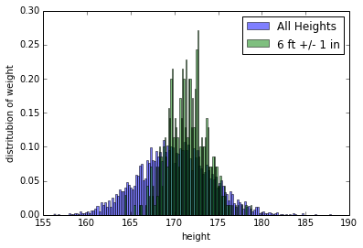
Reducing uncertainty
Step 2 – Based on prior knowledge, use the person’s height to get a better range of possible weights.
Notes:
The goal of finding structure is to information from one source to reduce uncertainty about another source.
What does this mean? Conditional distribution example. I.e., carnival guy who guesses your weight. If I can see your height I can reduce uncertainty about weight.
Find some height/weight data.
Under supervised exploration:
How can we (automatically) obtain a selection of the more informative variables with respect to predicting the value of the target variable?
Even better, can we obtain the ranking of the variables?
Can think of importance as one that makes the target variable more pure. This leads to the notion of entropy.

Slide 9
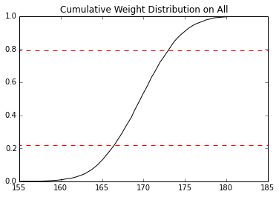
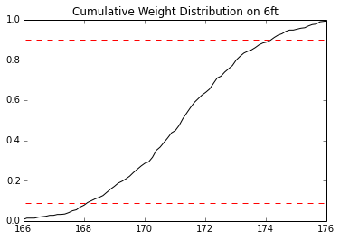
Reducing uncertainty
Step 3 – Guess E[W|H=72]. With a more informed, conditional expectation, he can reduce losses by 50% (40/100 vs. 20/100). That could be a lot of $$$.
Error Rate =
1-P(Correct | Guess E[W])
= 40%
Error Rate =
P(Correct | Guess E[W]|H=72)
= 20%
Notes:
The goal of finding structure is to information from one source to reduce uncertainty about another source.
What does this mean? Conditional distribution example. I.e., carnival guy who guesses your weight. If I can see your height I can reduce uncertainty about weight.
Find some height/weight data.
Under supervised exploration:
How can we (automatically) obtain a selection of the more informative variables with respect to predicting the value of the target variable?
Even better, can we obtain the ranking of the variables?
Can think of importance as one that makes the target variable more pure. This leads to the notion of entropy.

Slide 10
Types of structure
Pairwise (i.e., between 2 variables)
Global (i.e., across a matrix, or within a
set of variables)
Supervised (technically includes the
above, but with special emphasis
on a single target variable)
Notes:
The goal of finding structure is to information from one source to reduce uncertainty about another source.
What does this mean? Conditional distribution example. I.e., carnival guy who guesses your weight. If I can see your height I can reduce uncertainty about weight.
Find some height/weight data.
Under supervised exploration:
How can we (automatically) obtain a selection of the more informative variables with respect to predicting the value of the target variable?
Even better, can we obtain the ranking of the variables?
Can think of importance as one that makes the target variable more pure. This leads to the notion of entropy.

Slide 11
Types of structure
Pairwise (i.e., between 2 variables)
Notes:
The goal of finding structure is to information from one source to reduce uncertainty about another source.
What does this mean? Conditional distribution example. I.e., carnival guy who guesses your weight. If I can see your height I can reduce uncertainty about weight.
Find some height/weight data.
Under supervised exploration:
How can we (automatically) obtain a selection of the more informative variables with respect to predicting the value of the target variable?
Even better, can we obtain the ranking of the variables?
Can think of importance as one that makes the target variable more pure. This leads to the notion of entropy.

Slide 12
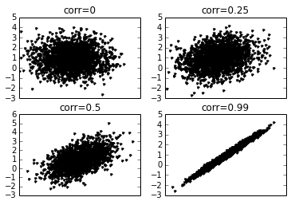
Covariance and correlation
These are probably the most used and thought of metrics when considering pairwise structure. These are statistical quantities and have a fairly intuitive geometric interpretation.
Scatter of Bi-Variate Normally Distributed Variables with various Correlations
Notes:
Do the demo as well

Slide 13
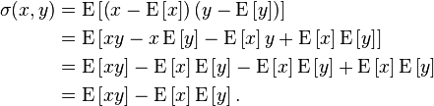

Covariance
Covariance
Sample Covariance (between Xj and Xk)
Note: I have decided to pull equations often from wikipedia, as I feel wp represents a crowd-sourced vote on notation standardization: http://en.wikipedia.org/wiki/Covariance
Notes:
Do the demo as well

Slide 14

correlation
Aka: Pearson-Product Moment Correlation Coefficient. This is just the covariance normalized by the variance of each variable. This scales correlation to the interval [-1,1], which makes it a very intuitive tool for analysis and reporting.
Correlation
Sample Correlation
Almost any programming language has standard functions for these formulas, but it doesn’t hurt to understand them!
Equation Source: http://en.wikipedia.org/wiki/Covariance
Notes:
Do the demo as well

Slide 15
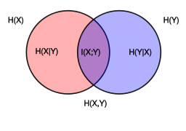

Mutual information
This comes from Information Theory, is used often for feature importance ranking and is related to important aspects of Decision Tree algorithms.
Mutual Information
Image and formula source: http://en.wikipedia.org/wiki/Mutual_information
Notes:
Do the demo as well

Slide 16
Mutual information
Let’s break this down
Mutual Information
This is in the form of E[F], i.e., E[X]=Σp(F)*F.
In this case, what is X?
Notes:
Do the demo as well

Slide 17
Mutual information
Let’s break this down
Mutual Information
F=log(p(x,y)/(p(x)*p(y))….but what is this?
Notes:
Do the demo as well

Slide 18
Mutual information
Let’s break this down
Mutual Information
F=log(p(x,y)/(p(x)*p(y))….but what is this?
This is a quantity with the following properties:
If X,Y are independent, F=0
If X,Y are completely dependent, F is at a maximum
F is symmetric (F(x,y)=F(y,x))
Notes:
Do the demo as well

Slide 19
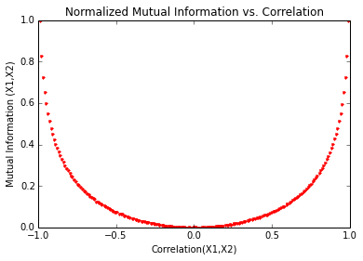
Mi vs correlation
Scikit-learn has functions for MI and normalized Mutual Information. We can see that MI and correlation are monotonically related concepts, though MI is strictly positive so does not indicate negative dependencies.
Notes:
Note, mutual information is the expected value of information gain.

Slide 20
Putting these to use
General understanding of dependencies in data
Validating assumptions for statistical modeling
Feature ranking and selection
Decision Tree Algorithms
Notes:
Note, mutual information is the expected value of information gain.

Slide 21
Types of structure
Global (i.e., across a matrix, or within a set of variables)
Notes:
The goal of finding structure is to information from one source to reduce uncertainty about another source.
What does this mean? Conditional distribution example. I.e., carnival guy who guesses your weight. If I can see your height I can reduce uncertainty about weight.
Find some height/weight data.
Under supervised exploration:
How can we (automatically) obtain a selection of the more informative variables with respect to predicting the value of the target variable?
Even better, can we obtain the ranking of the variables?
Can think of importance as one that makes the target variable more pure. This leads to the notion of entropy.

Slide 22
Data is multivariate
We usually want to go beyond pairwise similarity and understand how much “information” is actually embedded in a matrix.
We also might want to know what groups of features are related.
In an Nx2 matrix, this problem reduces to the pairwise methods just discussed.
Notes:
Do the demo as well

Slide 23
Singular value decomposition
Although this is not a linear algebra course, this equation happens so often in data analysis that it is worth learning (again).
X = U Σ V^{T}
NxM
NxM
MxM
(MxM)^{T}
We will not dive into all of the theoretical aspects of SVD and related topics. Our goal here is to understand it intuitively and be able to use it as a tool for solving other common Data Science problems.
Notes:
Do the demo as well

Slide 24
Singular value decomposition
Lets go through this piece by piece:
U
U holds the left singular vectors. Each row contains k elements that correspond to the latent factors of each row of X. U is orthonormal.
Σ
Σ is a diagonal matrix that holds the singular values (in descending order). The singular values are essentially weights that determine how much that latent factor contributes to the matrix.
V^{T}
V holds the right singular vectors. Each row contains k elements that correspond to the latent factors of each column of X. V is orthonormal.
Notes:
Do the demo as well

Slide 25
Singular value decomposition
How does this relate to structure?
Lets recall these scatter plots. Each plot can be expressed as an Nx2 Matrix. The SVD is a tool that can help us understand how much information or structure is actually in the matrix.
More independence of columns = more information or degrees of freedom.
Less independence of columns = less information or degrees of freedom.
Notes:
Do the demo as well

Slide 26
Singular value decomposition
Using Scipy we can easily compute the SVD.:
U,Sig,Vt = scipy.linalg.svd(matrix)
Σ =
45
44
Σ =
50
38
Σ =
53
32
62
5
Σ =
The magnitude of the singular-values are generally determined by the magnitude of the values in X. The relative difference between singular values is a function of the level of independence of the columns.
Notes:
Do the demo as well

Slide 27
Singular value decomposition
We can see that less independence of the columns leads to singular values with more skew from each other.
Notes:
Do the demo as well

Slide 28
Singular value decomposition
1
 | 0.8
 |  | 0.64
 |  |  | 0.512
 |  |  |  | 0.4096
 |  |  |  |  | 0.32768
 |  |  |  |  |  | 0.262144
 |  |  |  |  |  |  | 0.2097152
 |  |  |  |  |  |  |  | 0.16777216
 |  |  |  |  |  |  |  |  | 0.134217728
 |  |  |  |  |  |  |  |  |  | 0
 |  |  |  |  |  |  |  |  |  |  | 0
This idea generalizes to more dimensions, which is where the SVD is extremely useful.
The skew of the singular values, and the shape of the cumulative sum curve can give us a sense of the degree of independence in a many dimensional matrix.
Σ=
Notes:
Do the demo as well

Slide 29
An incredibly useful application of SVD
One of the most powerful applications of the SVD is creating a low rank approximation of a data matrix. Many of the following methods are based on using the SVD to get a low rank approximation.
Data Compression
Dimensionality Reduction
Recommender Systems
Clustering in High Dimensions
Notes:
Do the demo as well

Slide 30
The low rank approximation
The rank of a matrix is the size of the largest number of independent columns of a matrix. The rank can be found by counting the number of singular values >0.
These SVs are greater than 0, but they are small. The add very little information to this matrix, and could even represent noise. What would happen if we set them to zero?
These SVs are zero so the rank of this matrix is 10
Notes:
Do the demo as well

Slide 31
The low rank approximation
We can build a matrix X_{k} that approximates our original matrix by doing the following:
Compute the SVD of X
Truncate U, Σ and V to take only the k highest columns & singular values
Multiply back together to get X_{k}
Low Rank Approximation – K<<M
X_{k} = U_{k} Σ_{k} V_{k}^{T}
NxM
NxK
KxK
(MxK)^{T}
Notes:
Do the demo as well

Slide 32
The low rank approximation
Our original matrix had 12 columns with a rank of 10. In our approximation, we decided to use k=6. The cumulative sum of singular values is related to the amount of information contained in the matrix. By using k=6, we lost some information, but not half.
What do we gain with the low rank approximation?
What do we lose?
Notes:
Do the demo as well

Slide 33
One Benefit of rank-k svd
Some facts
A floating point number uses 8 bytes of memory
An MxN matrix of floating point numbers uses 8*M*N bytes of memory.
Instead of storing X, lets use X_{k}, a low rank approximation
U_{k}
Σ_{k}
V_{k}^{T}
When separated…
8*K*(N+M+1) bytes
…this is 8*N*K bytes
…this is 8*1*K bytes
…this is 8*K*K bytes
If you choose K<<M, you could save a ton of space…
i.e. k=100,N=1MM,M=10k, the full X is 80 GB, whereas storing the decomposed components of X_{k} would only be 0.8 GB!
Notes:
Do the demo as well

Slide 34
The cost
This result comes from the Eckart-Young-Mirsky Theorem
If X is an nxm matrix and X_{k} is the rank-k approximation derived from the SVD, then the sum-of-squares error between the entries of X and X_{k} equals the square-root of the sum-of-squares of the singular values > k.
i.e.
Where the Frobenius norm is defined as:
Notes:
Talk about the least-squares approximation

Slide 35
The cost - example
Given a matrix with the Singular Values shown
below, the “Information Retained” shows:
This is very similar to the R² metric in linear regression, and it tells us how well our rank-k approximation “fits” the the original matrix from a least squares sense.
Analyzing a rank-k approximation like this gives us a tool to choose k.
Notes:
Talk about the least-squares approximation

Slide 36


building an efficient lookup table – the context
At Dstillery, we operate a mobile advertising bidding system.
A user initiates an ad call by using an App. The Exchange receives the ad call and passes it to Dstillery as an option to bid.
Ad Auction Exchange
If Dstillery places the highest bid, it sends an ad unit to the exchange to be displayed on the phone.
Notes:
Talk about the least-squares approximation

Slide 37
building an efficient lookup table – the problem
Dstillery would like to provide its clients with a web application for forecasting total impression opportunities in a given period. The client would enter a set of targeting criteria (location, app name, device type, etc.) and Dstillery would provide an estimate.
Impression Forecaster
Enter Targeting Criteria
Output
Your Estimated Opportunities=
500,000
Seems simple enough, but wait!
Notes:
Talk about the least-squares approximation

Slide 38
building an efficient lookup table – the naïve solution
An easy, brute force way to forecast is to just count the number of bid opportunities that happened in the past and use that as a forecast for the future.
State | Zip | Census | App | Device Type | Cnt
NY | 11222 | 1001 | Candy | Phone | 678
NY | 10003 | 1002 | HideMe | Phone | 77,794
NJ | 08096 | 2001 | Whoa | Tablet | 78,143
NJ | 08910 | 2002 | Stoopid | Phone | 1,112
PA | 07919 | 3001 | Flava | Tablet | 59,787
PA | 09199 | 3002 | BigStuff | Tablet | 5,000
… | … | … | … | … | …
TX | 77450 | 9982 | Scream | Phone | 66,953
This is easy to accomplish in a single map-reduce query. The challenge is we end up with a table that has ~ 100 MM rows. The problem is that:
Querying a 100 MM record table with a live web interface is way too slow!
Notes:
Talk about the least-squares approximation

Slide 39
building an efficient lookup table – efficient solution (1)
Step 1: Convert our table from a compound key-value format to a matrix.
State | Zip | Census | App | Device Type | Cnt
NY | 11222 | 1001 | Candy | Phone | 678
NY | 10003 | 1002 | HideMe | Phone | 77,794
NJ | 08096 | 2001 | Whoa | Tablet | 78,143
NJ | 08910 | 2002 | Stoopid | Phone | 1,112
PA | 07919 | 3001 | Flava | Tablet | 59,787
PA | 09199 | 3002 | BigDaddy | Tablet | 5,000
… | … | … | … | … | …
TX | 77450 | 9982 | Scream | Phone | 66,953
 | App-Device 1 | App-Device 2 | … | App-Device M
State,Zip,Census 1 | 1000 | 10,000 | … | 90
State,Zip,Census 2 | 500 | 4000 | … | 900
State,Zip,Census 3 | 2400 | 34000 | … | 800
State,Zip,Census 4 | 900 | 10,000 | … | 50
… | … | … | … | …
State,Zip,Census N | 50 | 900 | … | 100
Notes:
Talk about the least-squares approximation

Slide 40
building an efficient lookup table – efficient solution (2)
Step 2: Use SVD to decompose the matrix…store the top k rows/columns of the decomposed matrices.
U
Σ
V^{T}
Step 3: During query time, look up appropriate row/columns from decomposed matrix. Multiply to get estimate: Forecast = Σ σ_{i}*u_{i}*v_{i}
U
Σ
V^{T}
Notes:
Talk about the least-squares approximation

Slide 41
building an efficient lookup table – cost/benefit analysis
The original key-value table had 100MM rows
For U and V we have K, 10k element vectors
Each scan of original table costs O(100MM)
Scanning U and V costs 2*K*O(10k)
Business requirement on accuracy is that we are right in the order of magnitude (i.e., log-scale), which means we can keep K<<10k
X_{k}
U_{k}
Σ_{k}
V_{k}^{T}
vs.
Notes:
Talk about the least-squares approximation

Slide 42
dimensionality reduction
Sometimes a dataset has too many features for various algorithms (or storage systems to handle). Often times there is also a lot of redundancy of the data. The SVD gives us a way to reduce the number of variables without losing too much information.
Compute rank-k SVD
X_{k}=U_{k}Σ_{k}V_{k}^{T}
X V_{k}
We can create an NxK reduced matrix with This effectively becomes our new “X” matrix, and we do any analysis (clustering, modeling, etc.) with the reduced matrix.
X’ V_{k}
We can project any new data into the reduced space by,
and then use this in our algorithms.
Again, the optimal choice of K is dependent on the problem and will be a tradeoff between information loss vs. constraint tolerance.
Notes:
Do we use UkSk as the feature matrix, or do we use XVk?

Slide 43
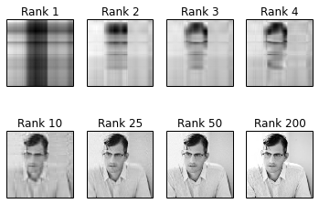
Image compression example in python
Images can be thought of as matrices of pixel color values. We can use SVD to build faces with different ranks. The full matrix here has rank=200 but we can see with a rank as low as 10 we capture most of the information we need to recognize the image.
Notes:
Do we use UkSk as the feature matrix, or do we use XVk?

Slide 44
To be continued…
Other applications of SVD are in recommender systems as well as clustering.
These will be presented in a later lecture.
Notes:
Talk about the least-squares approximation

